Slide 1



Build an
AUDIO_RECORDER
A.brahmaiah
R.Chandra Shekaer
Gopichand

Slide 2
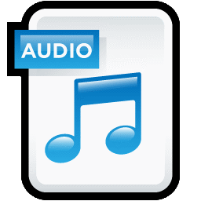
List of Contents
01
ABOUT PROJECT
02
PREREQUISITES
03
BUILD THE AUDIO RECORDER IN STEP-BY-STEP EXPLANATION
04
PROGRAMMING OF AUDIO RECORDER
05
SLIDES
06
SUMMARY

Slide 3
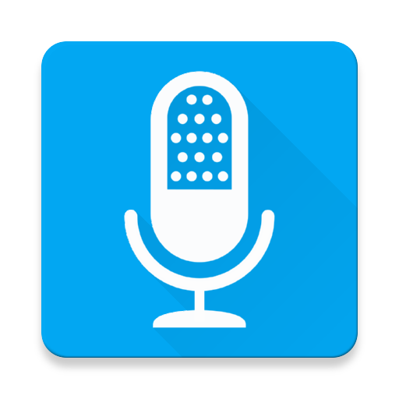
Let’s us Start
About Porject
Python can be used to perform a variety of tasks. One of them is creating a audio recorder using python. We can use various types of libraries in python’s sounddevice module to record and play audio. This module along with the wavio or the scipy module provides a way to save recorded audio
1

Slide 4
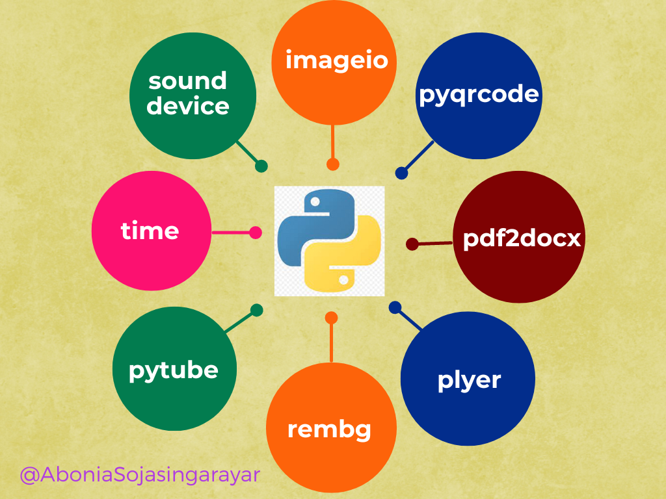
2.Prerequisites
Step-1
Python Installed
: If Python is not already installed, you can download it from the official website in python advanced version.
Step-2
Required Libraries:
sounddevice and tkiner,soundfile,threading and queue,libraries for audio recording and manipulation
❖ import tkinter : It is already available in python windows
❖ sudo apt-get install python3-tkinter, for ubuntu users
❖ sudo pacman -S tk, for arch linux users
2

Slide 5
3. Build the audio recorder in step-by-step explanation
2.Defining the functions
3. Creating the audio recorder GUI
4.Create the components and the button
1.Importing libraries
import sounddevice as sd
from tkinter import
import queue import
soundfile as sf import
threading from tkinter
import messagebox
. threading_rec()
. callback()
record_audio()
audio_recorder = Tk():
audio_rec.geometry(“360×200”):
audio_rec.title()
audio_rec.config(bg=”#107dc2″):
q = queue.Queue():
recording = False, file_exists = False:
title_lbl:
record_btn, stop_btn, play_btn:
grid(row=X,column=X):Place
audio_rec.mainloop():
3

Slide 6

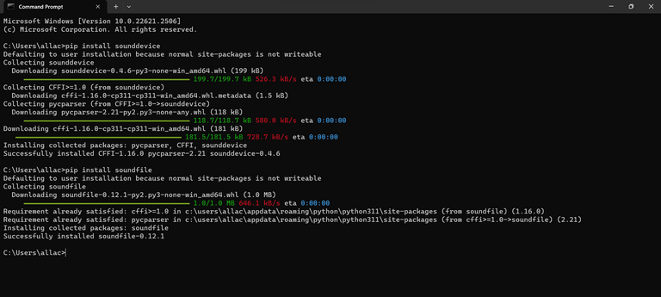
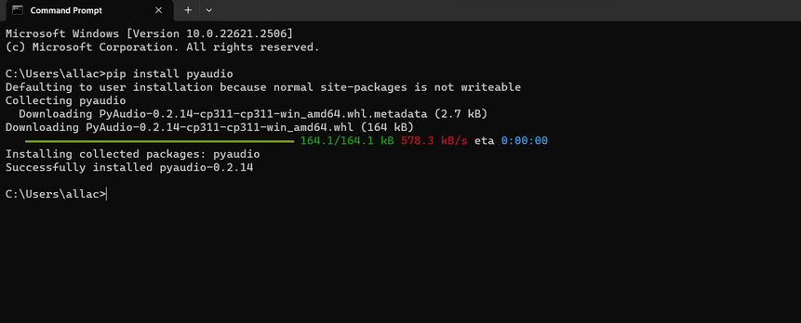
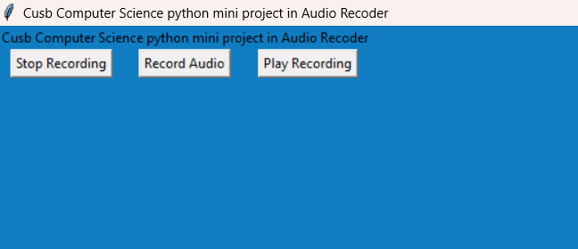
SLIDES
Slide-1
Slide-2
Slide-3
Output
4

Slide 7
Summary
Thus we created a simple Audio recorder from scratch using python. The project introduces audio libraries such as sounddevice and soundfile. We also came across a simple example of threading concept and its usage, along with a data structure
5

